Slide 1

House Price Prediction
Course Name: Artificial Intelligence
Course Code: CSA1706
Supervisor:
Dr. Krishna Kumar kathiresan
Presented by:
G. Gowthami(192524285)
G. Amrutha(192511250)

Slide 2
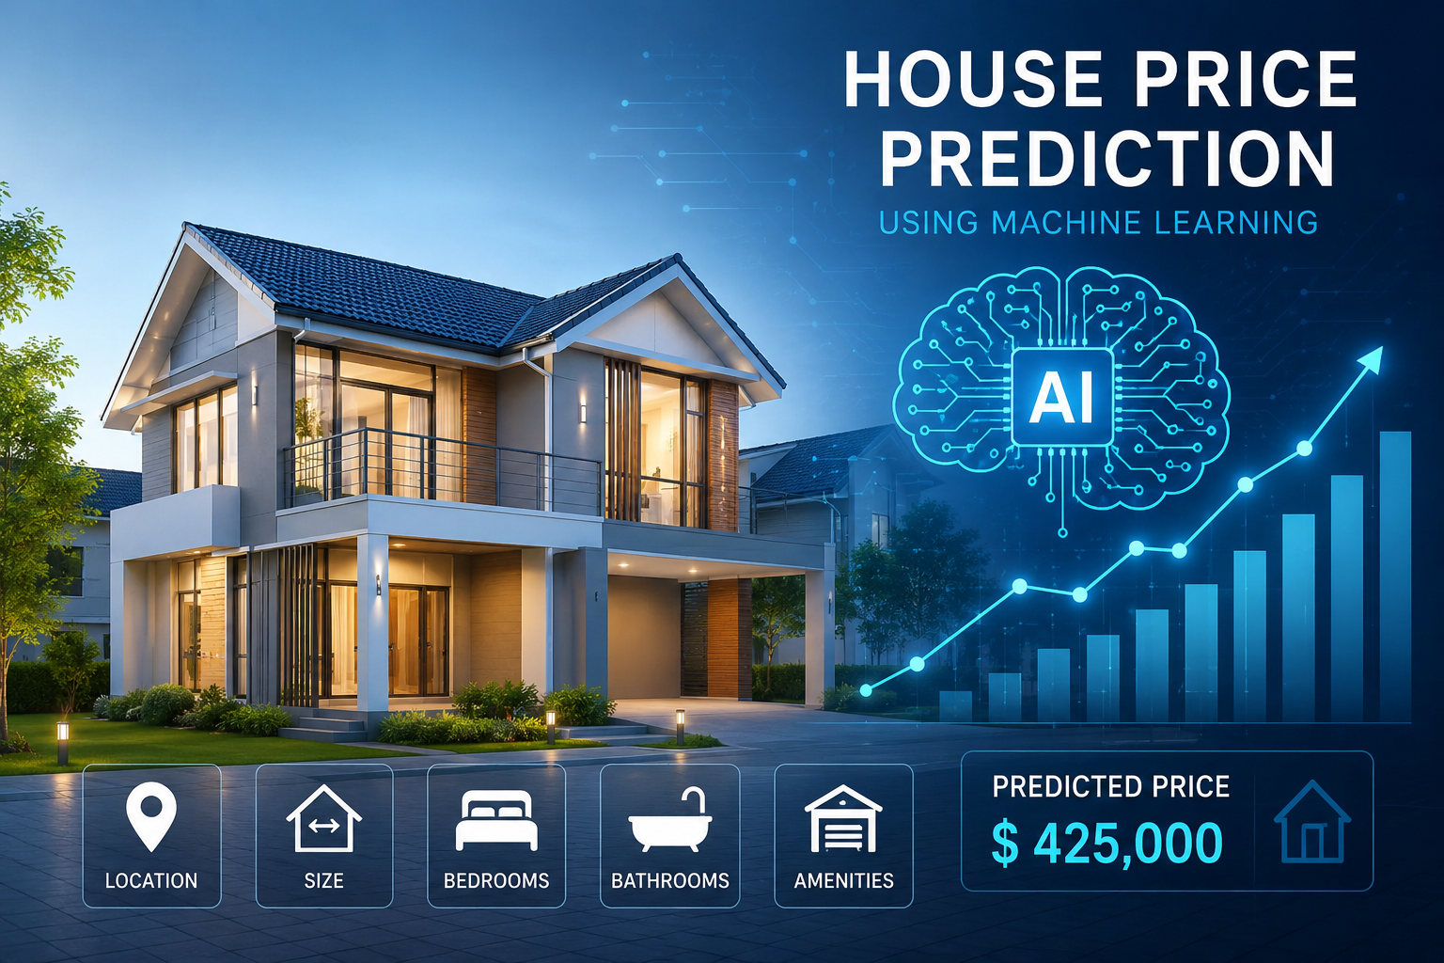
ABSTRACT
House price prediction helps estimate the market value of properties using machine learning.
It considers features such as location, size, number of bedrooms, bathrooms, and amenities.
Machine learning algorithms learn from historical housing data to make accurate predictions.
The system helps buyers, sellers, and real estate companies make better decisions.
The model improves prediction accuracy and reduces manual estimation.

Slide 3
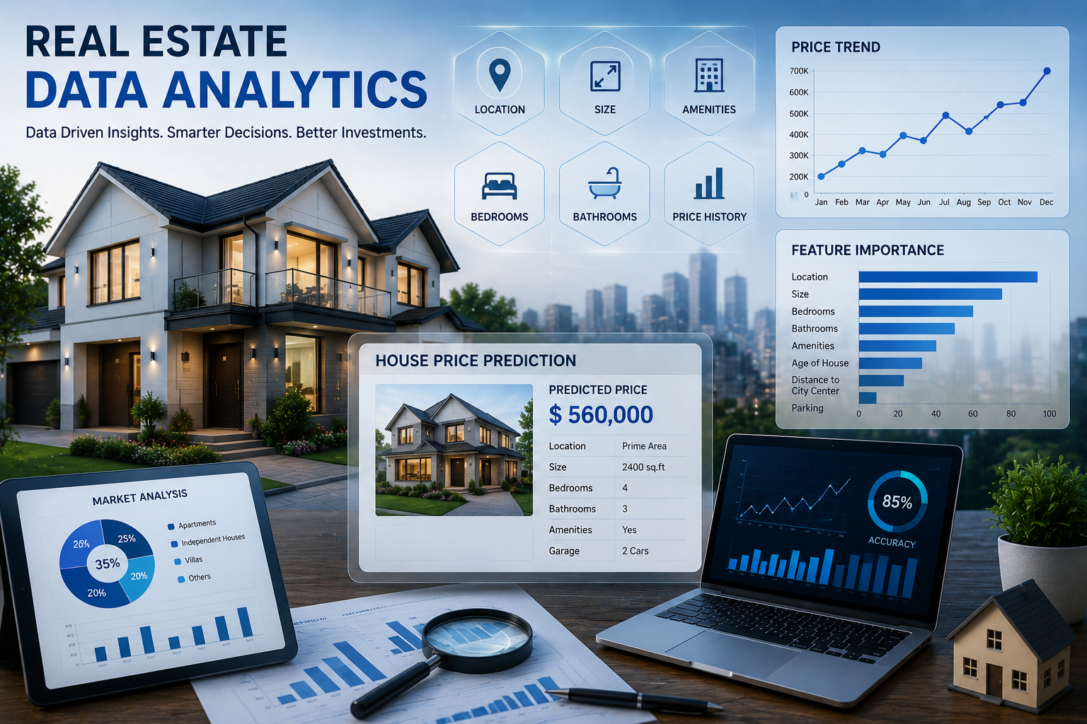
INTRODUCTION
House price prediction is one of the most important applications of machine learning in the real estate industry.
The value of a house depends on multiple factors such as location, area, number of bedrooms, bathrooms, age of the property, nearby facilities, and market demand.
Traditional methods of estimating house prices are often manual, time-consuming, and may produce inaccurate results.
Useful for buyers, sellers, and real estate businesses.

Slide 4
PROBLEM STATEMENT
Predict the selling price of a house based on various property-related features.
House prices vary depending on factors such as location, area, number of bedrooms, bathrooms, and amenities.
Manually estimating the price of a property can be time-consuming and inaccurate.
A machine learning model can be developed to learn patterns from historical house-price data.
The system will use features such as house size, number of rooms, location, age of the property, and other relevant attributes.

Slide 5
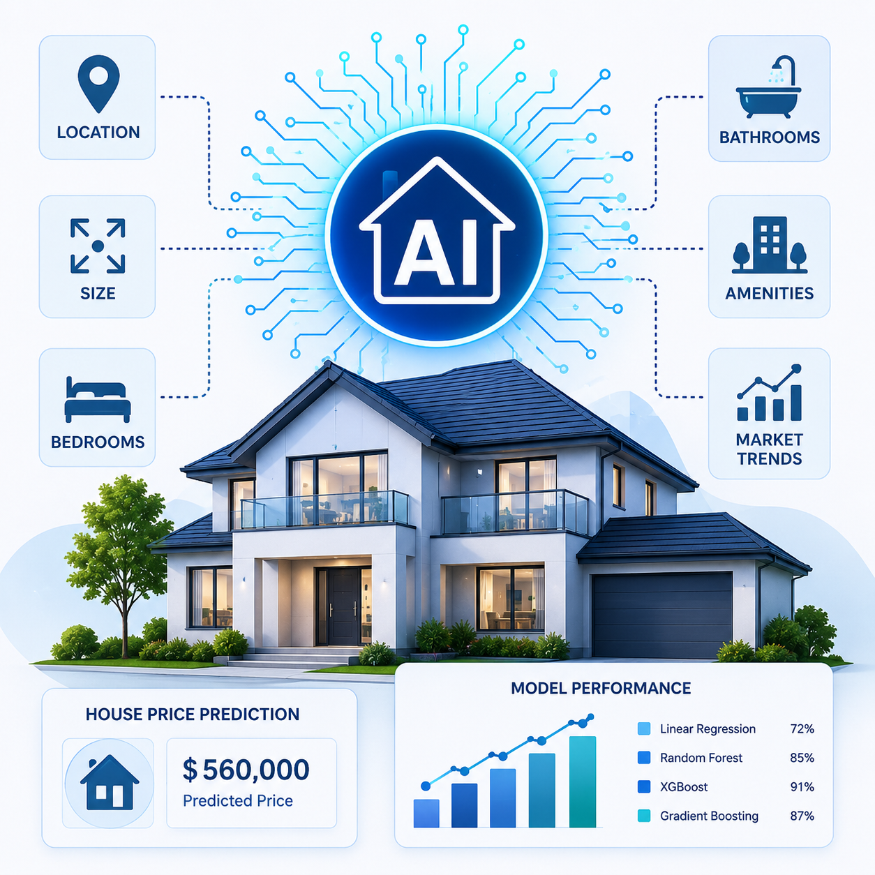
OBJECTIVES
To develop an intelligent house price prediction system using machine learning.
To collect and preprocess historical housing data for analysis.
To remove missing values and improve data quality through preprocessing.
To identify important features affecting house prices, such as location, area, bedrooms, bathrooms, and amenities.

Slide 6
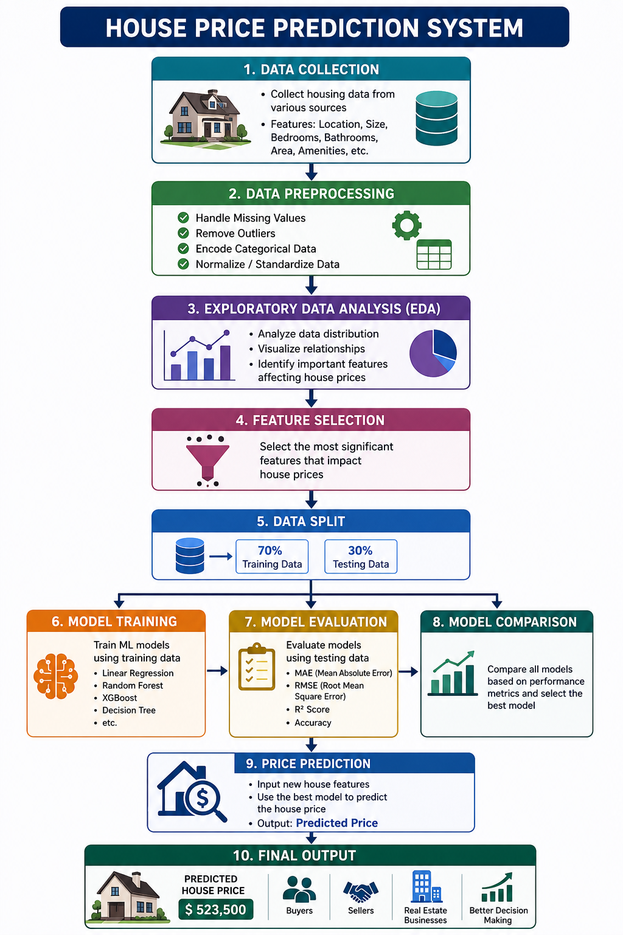
SYSTEM ARCHITECTURE

Slide 7
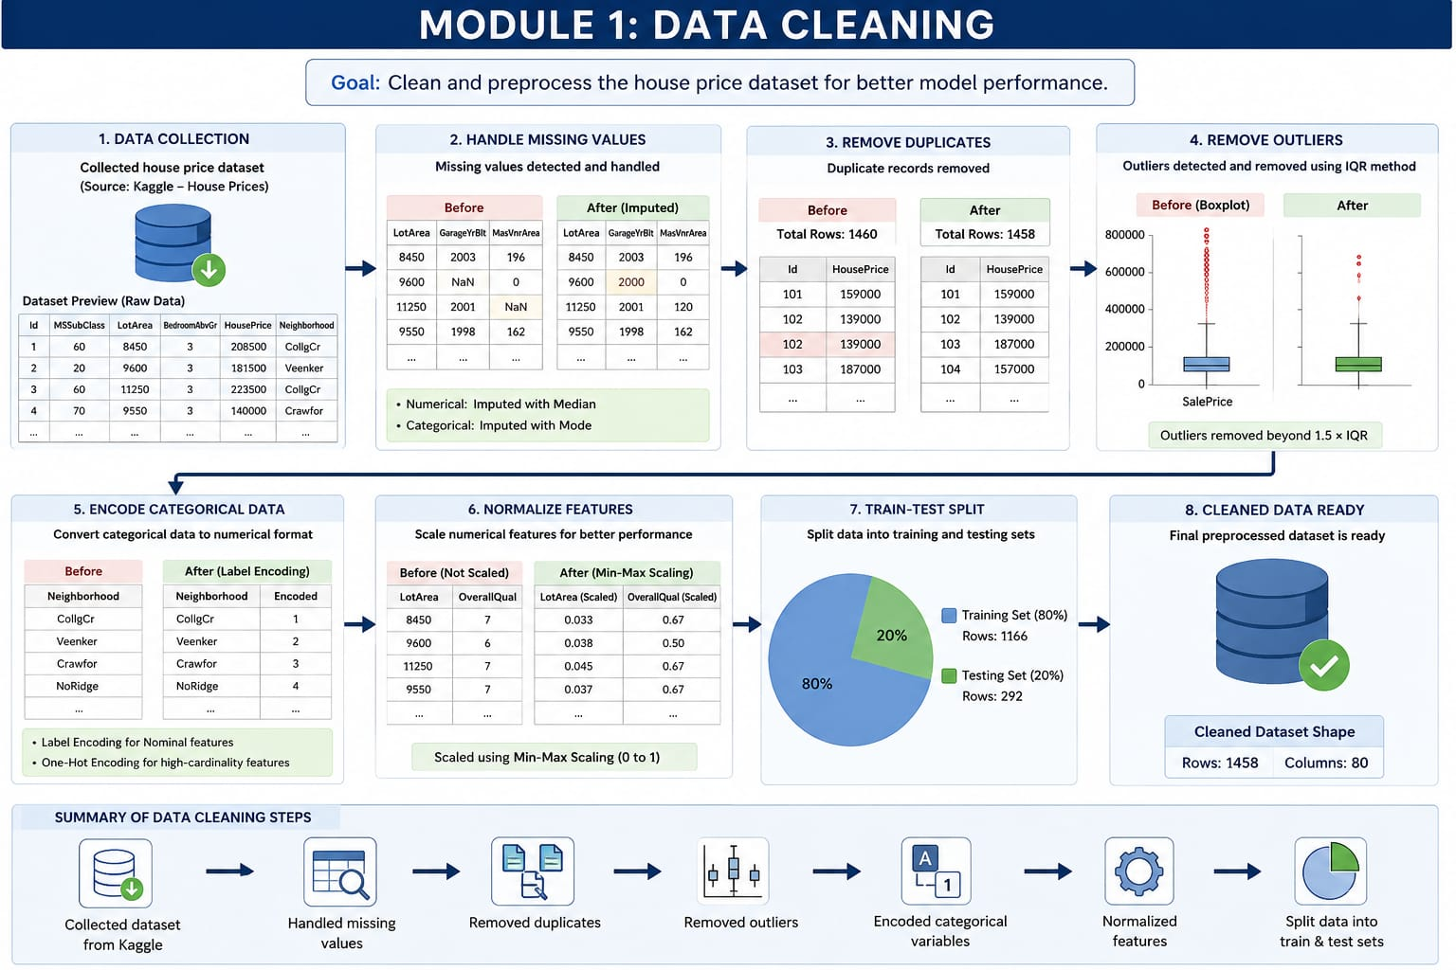
MODULE 1: DATA CLEANING
Collect the house price dataset from a reliable source.
Handle missing and duplicate values.
Remove outliers and inconsistent records.
Convert categorical data into numerical format.
Normalize and preprocess the data for better model performance.
Split the cleaned dataset into training and testing sets

Slide 8
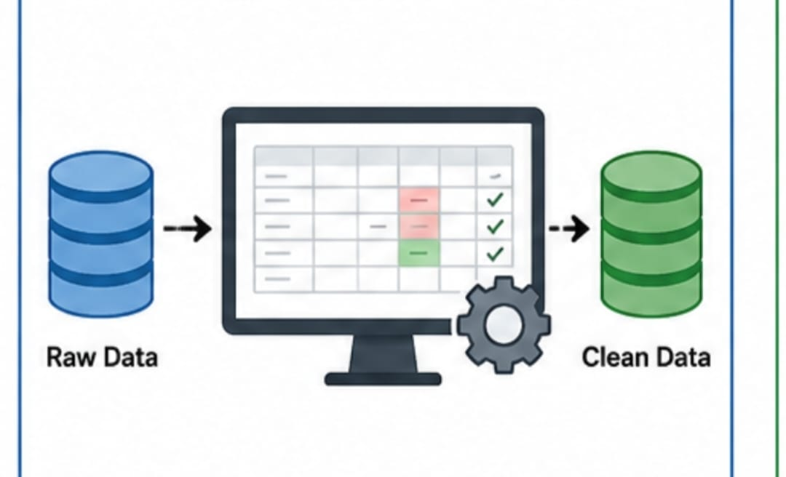
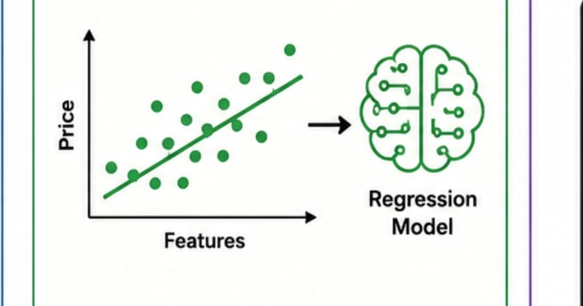
MODULE 2: REGRESSION MODEL
Apply a regression algorithm (e.g., Linear Regression) to the training data.
Train the model using important features such as location, area, bedrooms, and bathrooms.
Evaluate the model using metrics like Mean Absolute Error (MAE), Mean Squared Error (MSE), and R² Score.
Optimize the model to improve prediction accuracy.
Save the trained model for deployment.

Slide 9
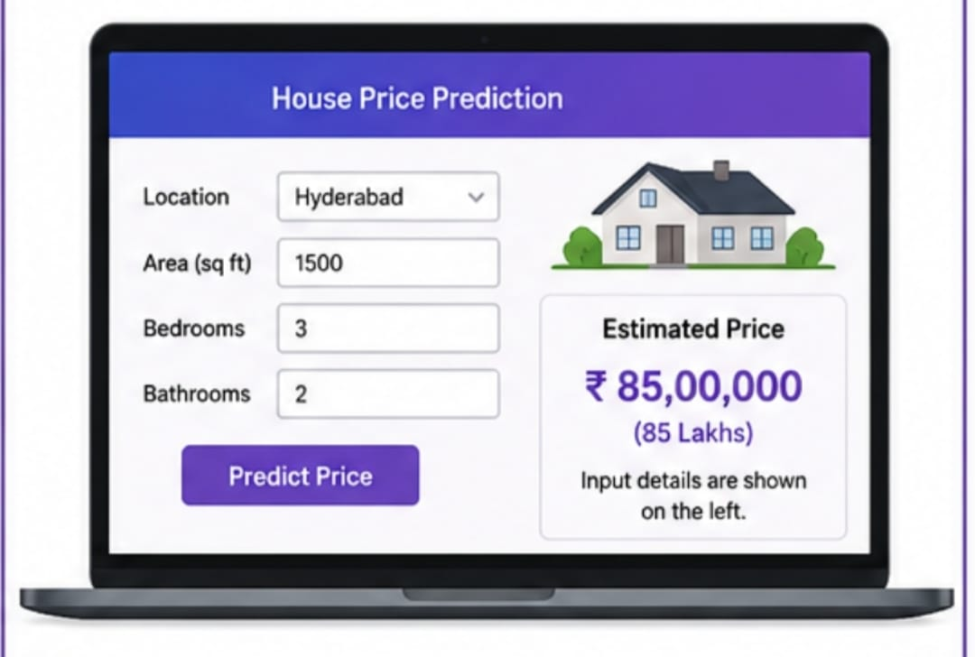
MODULE 3: PRICE PREDICTION PORTAL
Develop a user-friendly web interface.
Allow users to enter house details such as location, area, number of bedrooms, and bathrooms.
Load the trained regression model.
Predict the estimated house price instantly.
Display the predicted price clearly along with input details.
Provide a simple, responsive, and easy-to-use interface for users.

Slide 10
LITERATURE SURVEY
1. Smith et al. (2024)
Used Linear Regression for house price prediction.
Applied feature selection to improve prediction accuracy.
Achieved good performance on residential housing datasets.
Demonstrated that Linear Regression is effective for baseline prediction models.
2. Kumar et al. (2025)
Applied Random Forest Regression for house price estimation.
Used multiple property features such as location, area, and amenities.
Improved prediction accuracy compared to traditional methods.
Reduced overfitting using ensemble learning techniques.
3. Zhang et al. (2025)
Used the XGBoost algorithm for house price prediction.
Handled large housing datasets efficiently.
Achieved high prediction accuracy and faster training time.
Outperformed several conventional machine learning models.

Slide 11
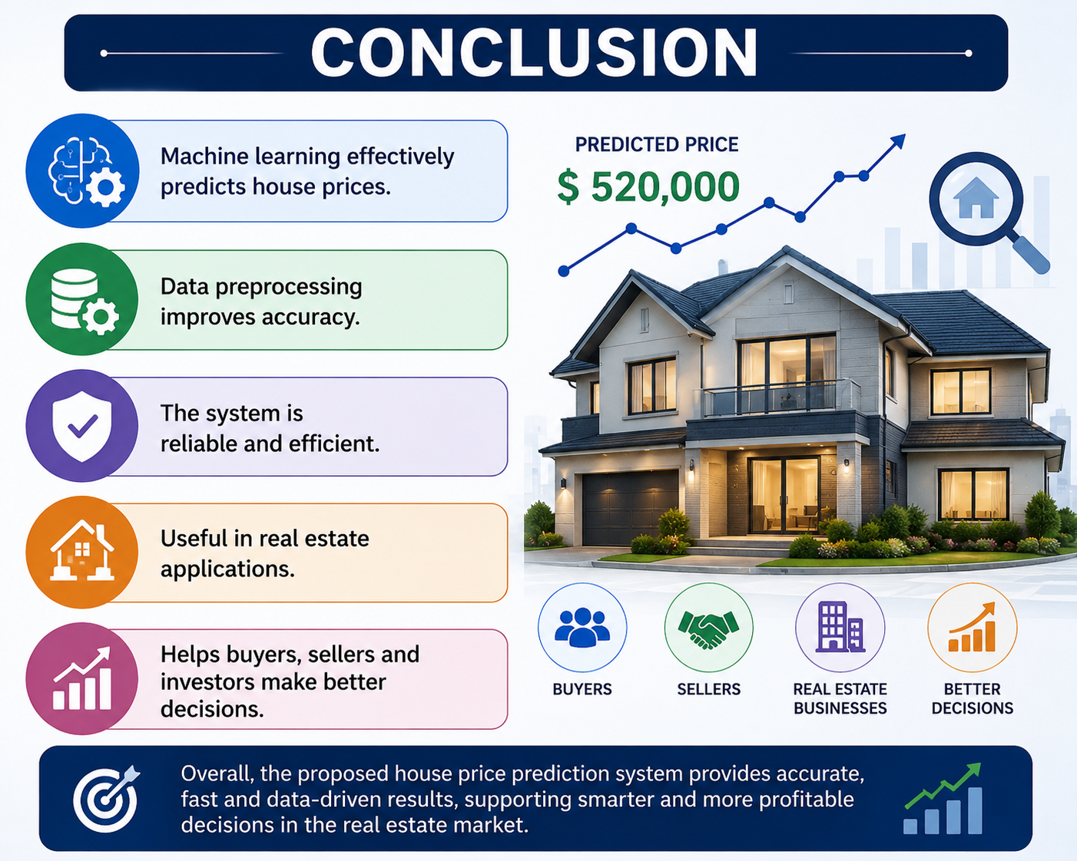
CONCLUSION
Machine learning provides an effective solution for predicting house prices with high accuracy.
Data preprocessing and feature engineering significantly improve the quality of predictions.
The system efficiently analyzes historical housing data to estimate property prices.
Machine learning models reduce manual effort and minimize human errors in price estimation
Overall, the proposed house price prediction system is reliable, efficient, and suitable for modern real estate applications.

Slide 12
Thank You!

